Slide 1

Team Details
Team Name: Team Shoonya
Team Leader Name: Yatharth Gautam
Problem Statement: Skilling: Difficulty in identifying the right skills to develop for future careers.

Slide 2

Brief Introduction to the Idea
SWOT Identification: Skill gap identification caused by rapid technological changes.
Personalized Learning: AI-powered personalized learning pathways.
Future Skills Forecasting: Big data analytics to predict necessary future skills.
Engaging Learning Content: Recommends courses, micro-credentials, roadmaps, and bootcamps.
Career Path Guidance: Provides clear recommendations on suitable career paths.

Slide 3
How different is it from any of the other existing ideas?
How will it be able to solve the problem?
USP of the proposed solution
SWOT Based Personalization
Comprehensive Assessment
Holistic User Profile
Future Skills Forecasting
Tailored Learning Pathways
Skill Gap Bridging
AI - driven SWOT analysis
Diverse Learning Options
Optimize Skill Development

Slide 4
List of features offered
Tailored Career Recommendation
AI-Driven Learning Pathways
Future Skill Forecasting
Dynamic Skill Assessment
SWOT Analysis
AI-Driven Skill Mapping
Adaptive Learning Paths
Market and Competitor Analysis
AI-Driven Career Suggestions
Job Market Insights
Customized Job Alerts
Personalized Learning Plans
Adaptive Content
Progress Monitoring
Predictive Analytics
Proactive Learning
Trend Analysis
Real Time Evaluation
Skill Gap Identification
Industry Benchmarking

Slide 5
Process flow diagram
Identify Skills Gap
Analyze Skills Gap Data
Yes
Skill Gaps
Found?
No
Create Personalized Learning Pathway
Review Skill Gap Analysis
Recommend Courses and Micro-Credentials
Review Existing Learning Content
Generate Learning Roadmaps and Bootcamps
Forecast Future Skills using Big Data Analytics
Analyze Industry Trends and Job Posts
Provide Career Path Guidance And Personalised Career Recommendations

Slide 6
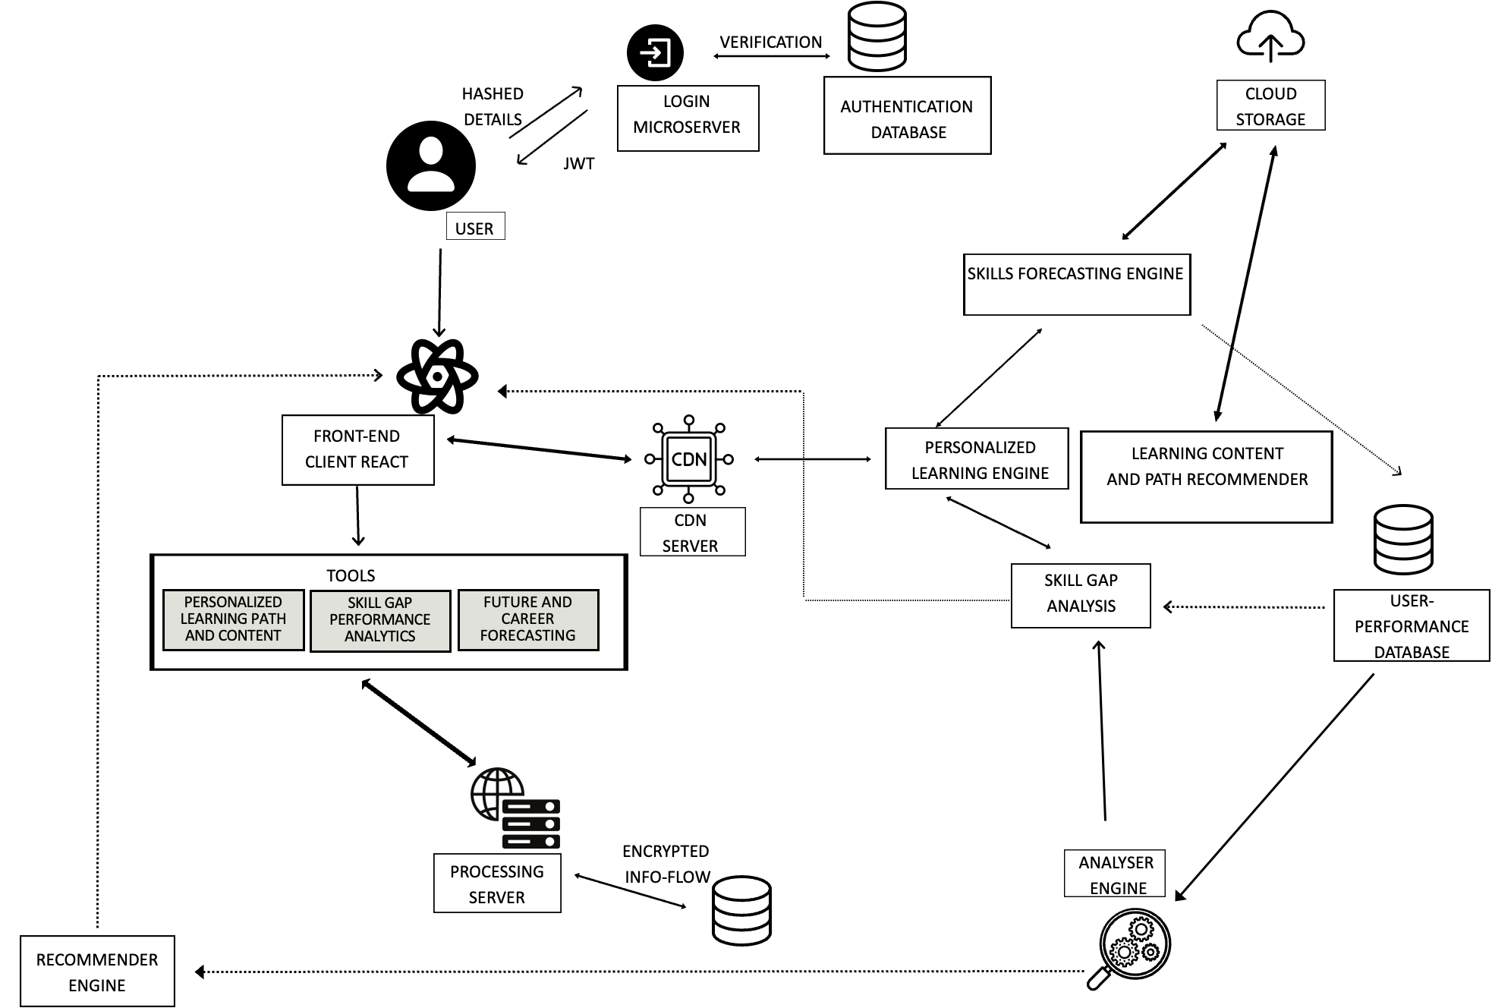
Architecture diagram

Slide 7











Technologies to be used in the solution
Frontend
HTML
CSS
Javascript
Bootstrap
React
Backend
Recommendation System
Tensorflow
Scikit learn
Pytorch
Natural Language Toolkit

Slide 8


